Slide 1
Theory of Automata and Formal Language
Lecture-30
Dharmendra Kumar
(Associate Professor)
Department of Computer Science and Engineering United College of Engineering and Research, Prayagraj March 30, 2021

Slide 2
Construction of PDA
In this section, we shall see how PDA’s can be constructed.
Ex. Construct PDA to accept the language L={ 0^{n}1^{n} ! n ≥ 1} by final state.
Solution: First we consider a string of a given language and check how it can accept.
Procedure:
In this language, since n numbers of 0’ are followed by n numbers of 1’s, therefore, to check equal number of 0 and 1, we have to push a symbol corresponding to 0 and pop that symbol corresponding to 1. Let that symbol is denoted by A.
Push stack symbol A in to the stack as long as scanned input symbol 0. When next scanned input symbol is 1, find top symbol of stack. If top symbol is A, then pop A from stack. When input pointer reaches at the end of string i.e. input string is empty, find top symbol of stack. If top symbol is Z_{0,} then machine goes to final state. And at this situation, machine accept string.

Slide 3
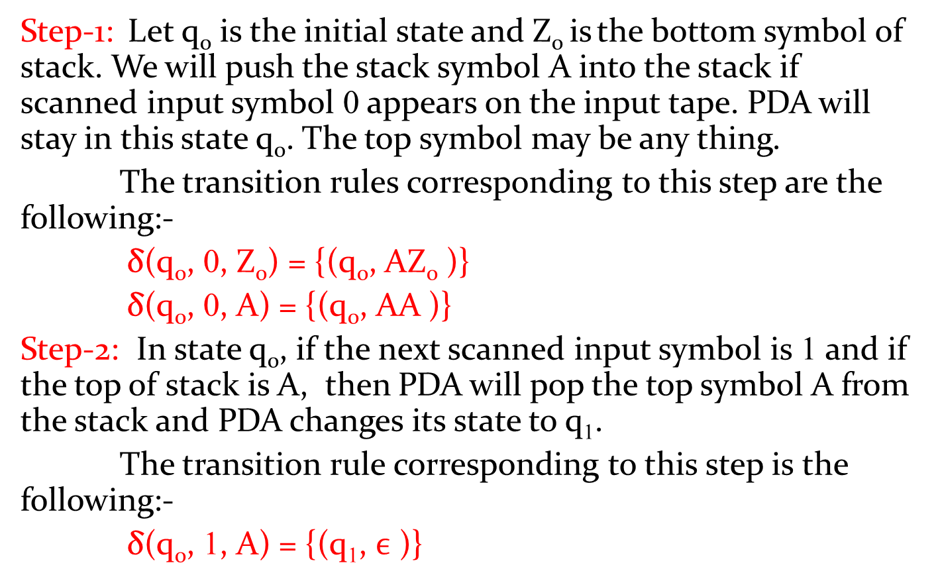
Ex. L={ 0^{n}1^{n} ! n ≥ 1} continue.
Step-1: Let q₀ is the initial state and Z₀ isthe bottom symbol of stack. We will push the stack symbol A into the stack if scanned input symbol 0 appears on the input tape. PDA will stay in this state q₀. The top symbol may be any thing.
The transition rules corresponding to this step are the following:-
δ(q₀, 0, Z₀) = {(q₀, AZ₀ )}
δ(q₀, 0, A) = {(q₀, AA )}
Step-2: In state q₀, if the next scanned input symbol is 1 and if the top of stack is A, then PDA will pop the top symbol A from the stack and PDA changes its state to q₁.
The transition rule corresponding to this step is the following:-
δ(q₀, 1, A) = {(q₁, $ϵ$)}

Slide 4
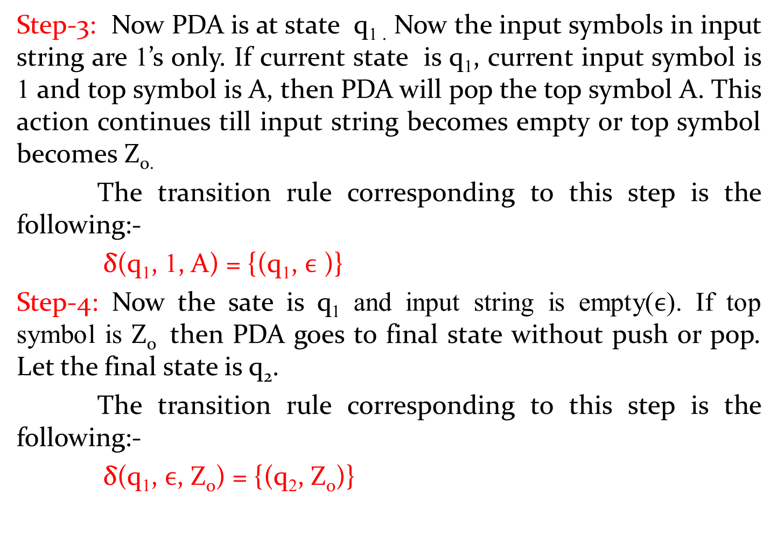
Ex. L={ 0^{n}1^{n} ! n ≥ 1} continue.
Step-3: Now PDA is at state q_{1 .} Now the input symbols in input string are 1’s only. If current state is q₁, current input symbol is 1 and top symbol is A, then PDA will pop the top symbol A. This action continues till input string becomes empty or top symbol becomes Z_{0.}
The transition rule corresponding to this step is the following:-
δ(q₁, 1, A) = {(q₁, $ϵ$)}
Step-4: Now the sate is q₁ and input string is empty($ϵ$). If top symbol is Z₀ then PDA goes to final state without push or pop. Let the final state is q₂.
The transition rule corresponding to this step is the following:-
δ(q₁, $ϵ$, Z₀) = {(q₂, Z₀)}

Slide 5

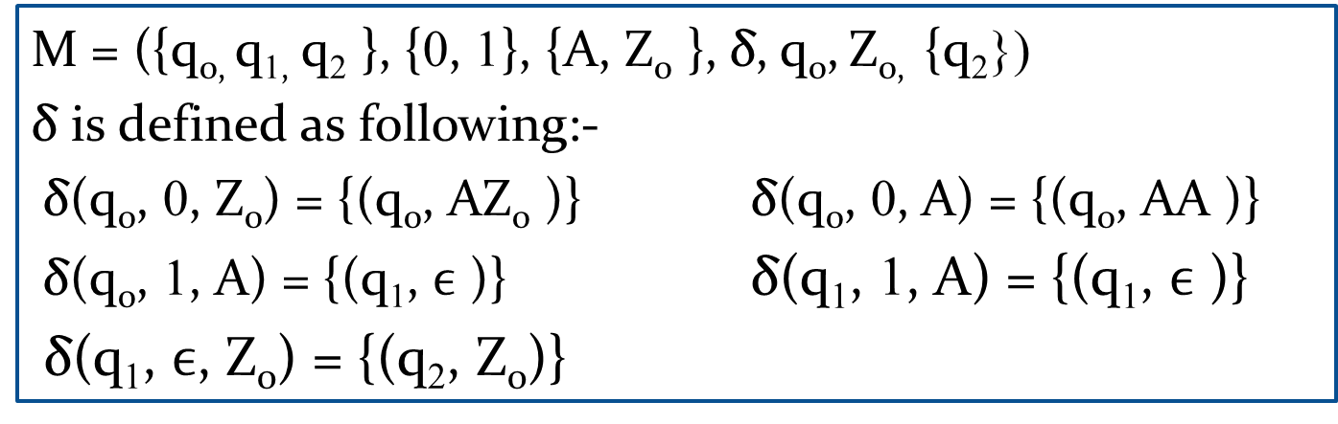


Ex. L={ 0^{n}1^{n} ! n ≥ 1} continue
Therefore final PDA is
M = ({q_{0,} q_{1,} q₂ }, {0, 1}, {A, Z₀ }, δ, q₀,Z_{0,} {q₂})
δ is defined as following:-
δ(q₀, 0, Z₀) = {(q₀, AZ₀ )} δ(q₀, 0, A) = {(q₀, AA )}
δ(q₀, 1, A) = {(q₁, $ϵ$ )} δ(q₁, 1, A) = {(q₁, $ϵ$ )}
δ(q₁, $ϵ$, Z₀) = {(q₂, Z₀)}
0, Z₀/AZ₀
0, A/AA
1, A/$ϵ$
q₀
q₁
q₂
1, A/$ϵ$
$ϵ$, Z₀/Z₀

Slide 6
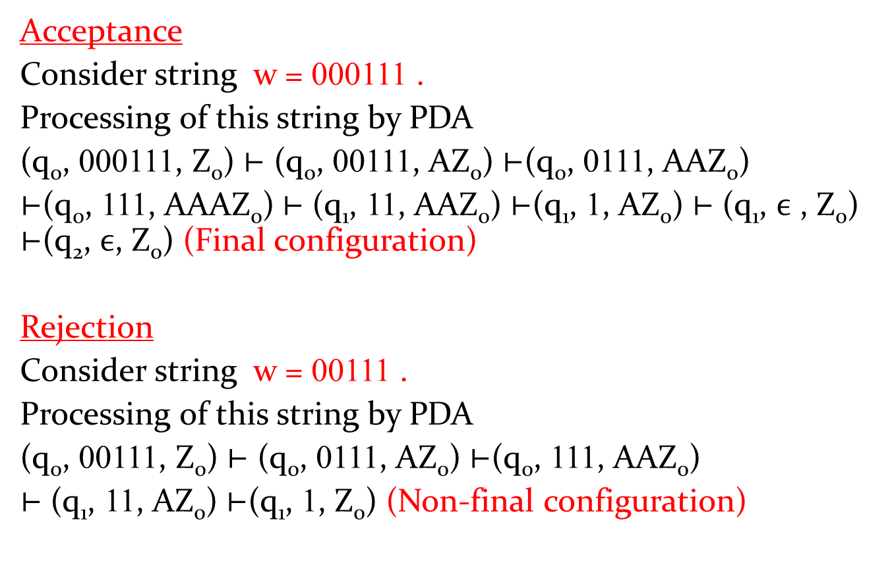
Processing and Verification of above PDA
Acceptance
Consider string w = 000111 .
Processing of this string by PDA
(q₀, 000111, Z₀) ⊢ (q₀, 00111, AZ₀) ⊢(q₀, 0111, AAZ₀)
⊢(q₀, 111, AAAZ₀) ⊢ (q₁, 11, AAZ₀) ⊢(q₁, 1, AZ₀) ⊢ (q₁,$ϵ$ , Z₀) ⊢(q₂, $ϵ$, Z₀) (Final configuration)
Rejection
Consider string w = 00111.
Processing of this string by PDA
(q₀, 00111, Z₀) ⊢ (q₀, 0111, AZ₀) ⊢(q₀, 111, AAZ₀)
⊢ (q₁, 11, AZ₀) ⊢(q₁, 1, Z₀) (Non-final configuration)

Slide 7
PDA examples continue
Ex. Construct PDA to accept the language
L = { wcw^{R} ! w ∈ {a, b}* } by final state.
Solution:
In this language, w is any string of a and b. w^{R} is the reverse string of w.
If w= abb, then string abbcbba ∈ L. Clearly all the strings belong in to L are palindrome.
Some strings belong in to this set are c, aca, bcb, abcba, bacab etc.
Procedure: In this PDA, we push symbol A and B in to the stack corresponding to input symbol a and b in input string. PDA will stay at the q₀. when c appears in input string, it changes its state to other state(Let it be q₁) without push or pop. At q₁ state, it only pop.
If current input symbol is a and top symbol is A, then pop the top symbol A.
Similarly, If current input symbol is b and top symbol is B, then pop the top symbol B.
At last if input string is empty and top symbol is Z_{0,} then machine goes to final state.

Slide 8
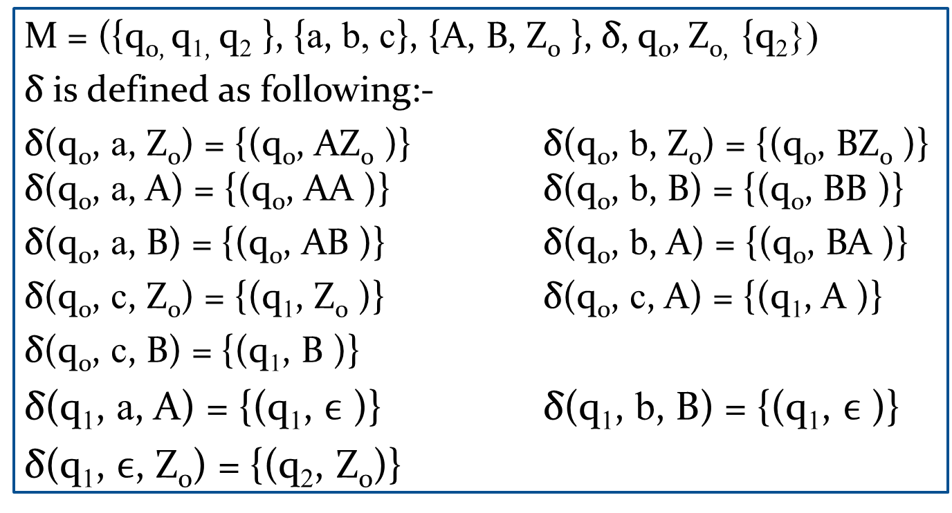
Ex. L={ wcw^{R} ! w ∈ {a, b}* } continue
Therefor e the PDA corresponding to above language is constructed as following:-
M = ({q_{0,} q_{1,} q₂ }, {a, b, c}, {A, B, Z₀ }, δ, q₀,Z_{0,} {q₂})
δ is defined as following:-
δ(q₀, a, Z₀) = {(q₀, AZ₀ )} δ(q₀, b, Z₀) = {(q₀, BZ₀ )} δ(q₀, a, A) = {(q₀, AA )} δ(q₀, b, B) = {(q₀, BB )}
δ(q₀, a, B) = {(q₀, AB )} δ(q₀, b, A) = {(q₀, BA )}
δ(q₀, c, Z₀) = {(q₁, Z₀ )}δ(q₀, c, A) = {(q₁, A )}
δ(q₀, c, B) = {(q₁, B )}
δ(q₁, a, A) = {(q₁, $ϵ$ )}δ(q₁, b, B) = {(q₁, $ϵ$ )}
δ(q₁, $ϵ$, Z₀) = {(q₂, Z₀)}

Slide 9


Ex. L={ wcw^{R} ! w ∈ {a, b}* } continue
Transition diagram of PDA is the following:-
a, A/$ϵ$
b, B/$ϵ$
a, Z₀/AZ₀
a, A/AA
a, B/AB
b, Z₀/BZ₀
b, A/BA
b, B/BB
q₀
q₁
q₂
c, Z₀/Z₀
c, A/A
c, B/B
$ϵ$, Z₀/Z₀

Slide 10
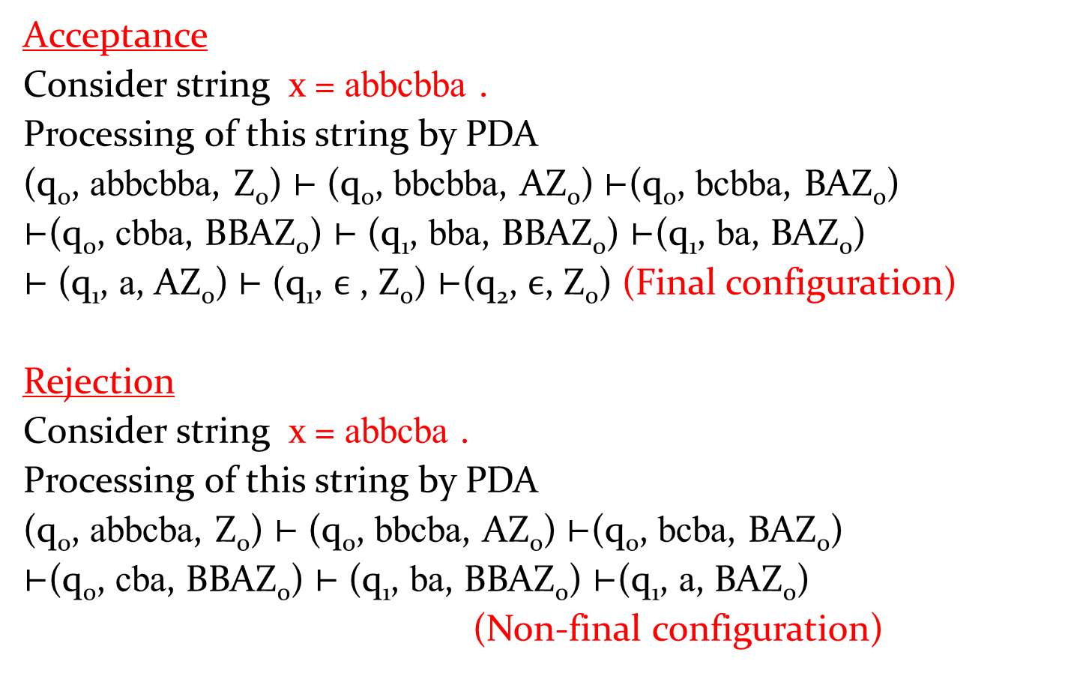
Processing and Verification of above PDA
Acceptance
Consider string x= abbcbba.
Processing of this string by PDA
(q₀, abbcbba, Z₀) ⊢ (q₀, bbcbba, AZ₀) ⊢(q₀, bcbba, BAZ₀)
⊢(q₀, cbba, BBAZ₀) ⊢ (q₁, bba, BBAZ₀) ⊢(q₁, ba, BAZ₀)
⊢ (q₁, a, AZ₀) ⊢ (q₁,$ϵ$ , Z₀) ⊢(q₂, $ϵ$, Z₀) (Final configuration)
Rejection
Consider string x = abbcba.
Processing of this string by PDA
(q₀, abbcba, Z₀) ⊢ (q₀, bbcba, AZ₀) ⊢(q₀, bcba, BAZ₀)
⊢(q₀, cba, BBAZ₀) ⊢ (q₁, ba, BBAZ₀) ⊢(q₁, a, BAZ₀)
(Non-final configuration)

